Slide 1
PERL OOPs

Slide 2
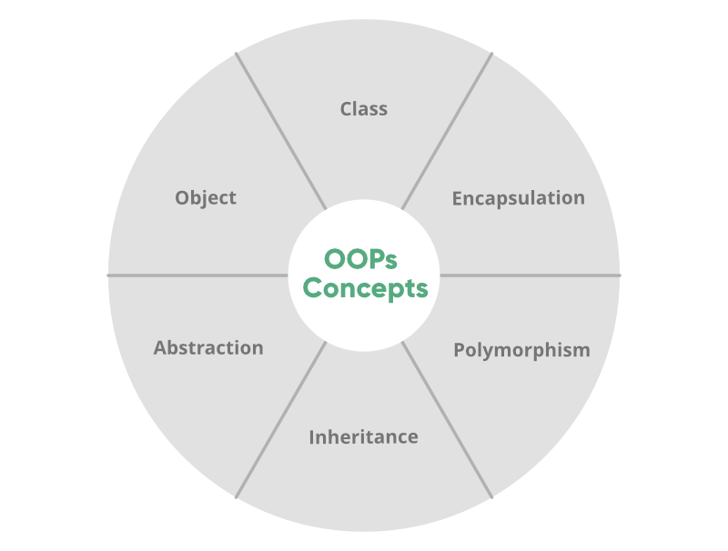
OOPS
Object-oriented programming aims to implement real-world entities like inheritance, hiding, polymorphism, etc in programming.
The main aim of OOP is to bind together the data and the functions that operate on them so that no other part of the code can access this data except that function.

Slide 3
Object
An object is an instance of a class of the data structure with some characteristics and behavior.
In the concept of OOPs, the characteristics of an object are represented by its data and the behavior is represented by its associated functions.
Thus an object is an entity that stores data and has its interface through functions.

Slide 4
Class
A class is an expanded concept of data structures.
It defines a prototype blueprint of objects comprising of data. And an object is an instance of a class.
A class comprises of the data members and data functions and it is a pre-defined data type made as per the user’s requirements which can be accessed and used by creating an instance of that class.

Slide 5
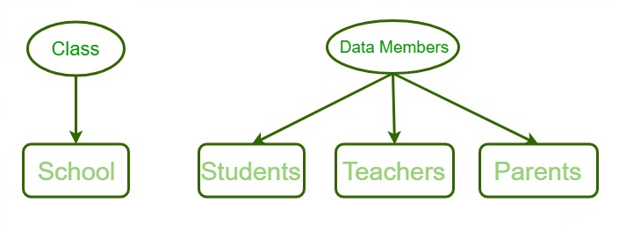
Class
A class is an expanded concept of data structures.
It defines a prototype blueprint of objects comprising of data. And an object is an instance of a class.
A class comprises of the data members and data functions and it is a pre-defined data type made as per the user’s requirements which can be accessed and used by creating an instance of that class.

Slide 6
Defining a Class
It is very easy to define a class in Perl.
In Perl, a Class corresponds to a package.
To define a class we first load and build a Package.
A Package is a pre-contained unit of user-defined variables and subroutines, which can be used throughout the program.
Syntax:
package Class_name

Slide 7
Creating Class and Using Objects
A class in Perl can be created by using the keyword package but to create an object, a constructor is called.
A constructor is defined in a class as a method.
Creating an instance of a class
A class name and a constructor name can be as per user’s requirement.
Most of the programmers prefer to use ‘new’ as a constructor name for their programs as it is easy to remember and is more feasible to use than any other complex constructor name.

Slide 8
Creating Class and Using Objects
package student // This is the class student
sub Student_data // Constructor to class
{
my $class = shift;
my $self = {
-StudentFirstName => shift;
-StudentLastName => shift;
};
print "Student's First Name is $self ->{_StudentFirstName}\n";
print "Student's Last Name is $self ->{_StudentLastName}\n";
bless $self, $class;
return $self;
}

Slide 9
THANK YOU

